Slide 1

Specialized OCR on Detecting Car Plates
Jesse Huang, Shuyi Teng (Sarah)
CS 6476 Class Project

Slide 2

Recognizing a license plate might be easy at first glance
Any OCR tool probably is able to tell what is the license information in the picture on the right
Image credit: https://www.boredpanda.com/funny-license-plates/?utm_source=google&utm_medium=organic&utm_campaign=organic

Slide 3
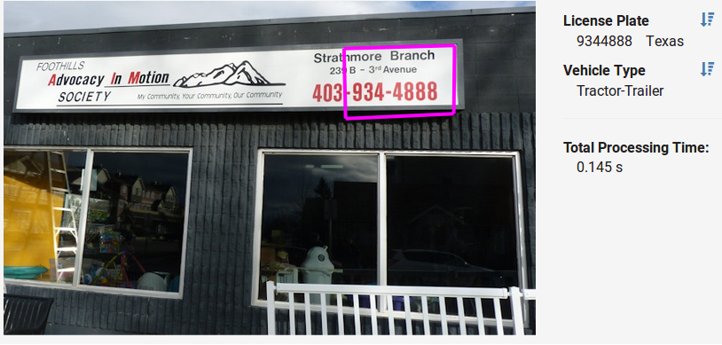
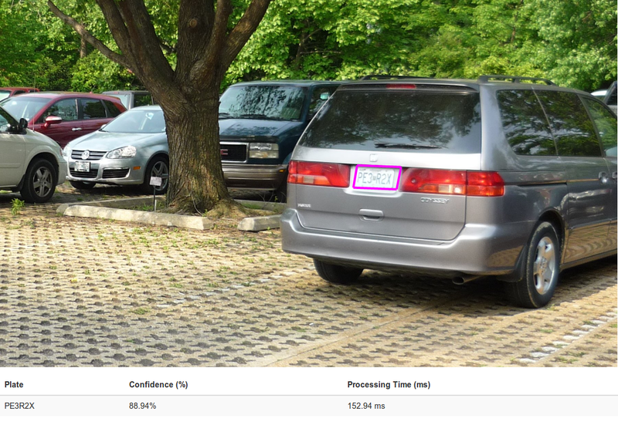
But in here, which numbers are license plates?

Slide 4
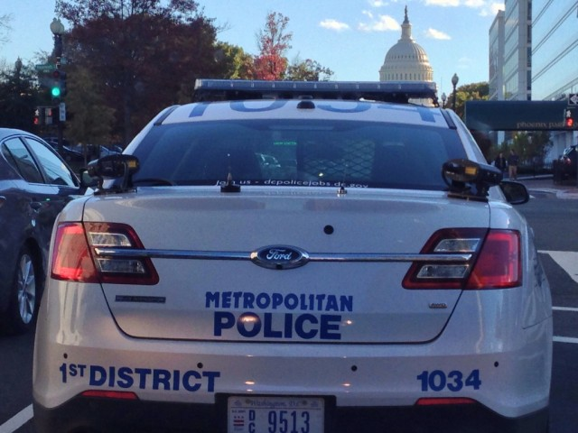
How about this one?
Image credit: https://arstechnica.com/tech-policy/2014/05/license-plate-reader-firm-releases-dubious-poll-to-show-public-support/

Slide 5
Our Idea
In this project, we want to extract the license plate numbers from cars without including any superfluous information.
Our system should take in pictures with mixed texts and still be able to detect the correct license plate number.

Slide 6
Dataset
We will use the dataset “OpenALPR benchmark” from this website: https://platerecognizer.com/number-plate-datasets with focus on just US license plates.
222 Images of front / back oriented cars and trucks, with attached text files indicating license plate numbers.

Slide 7
Approach
Our approach is to combine different computer vision strategies to extract information from license plates. We will separate regions of the images use methods like K-means clustering (depends on which one has better performance). After identifying regions of interest we will perform OCR on the regions. For OCR we will be utilizing OpenALPR. To calculate the accuracy we use Accuracy = Total Correct Characters / Total Characters.

Slide 8
Work Pipeline
1
2
3
4
Collect Dataset
Image Segmentation
OCR for license plates
Evaluation
Collect and build the image dataset we need for the project
Separate images using different method: keans, canny, etc
OpenALPR
Evaluate the results using different segmentation techniques

Slide 9
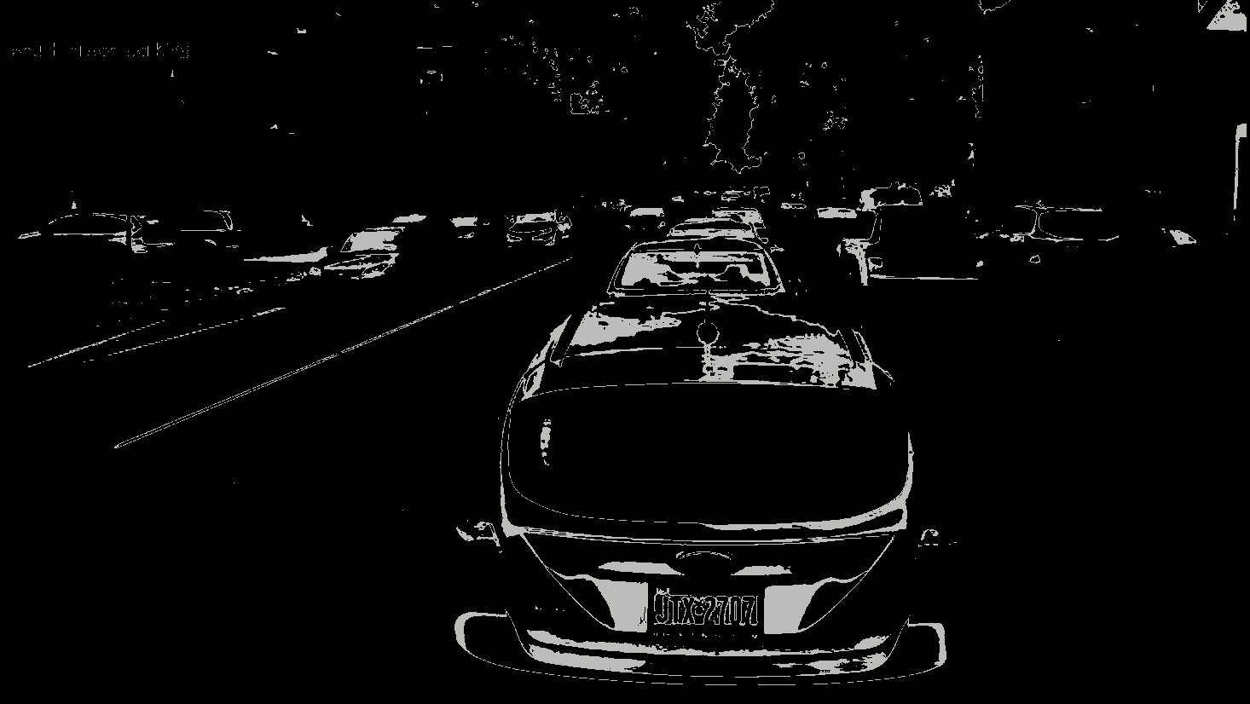
K-means Example (k=15, center No.2)
K Means has very different performance on different pictures, and for higher accuracy we may need to examine the centers that have the best result.
It can filter out some text information with has different color/texture than the plate.

Slide 10
OCR Output Example
Predicted License Plate: JTX2700
Actual: JTX2707
Confidence: 75%

Slide 11
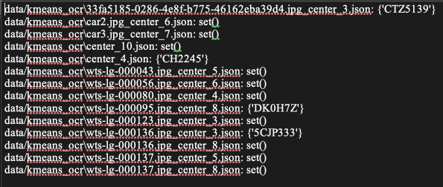
Comparison of Accuracy
KMeans + OpenAPLR 92.6%
Open APLR 91.0%

Slide 12
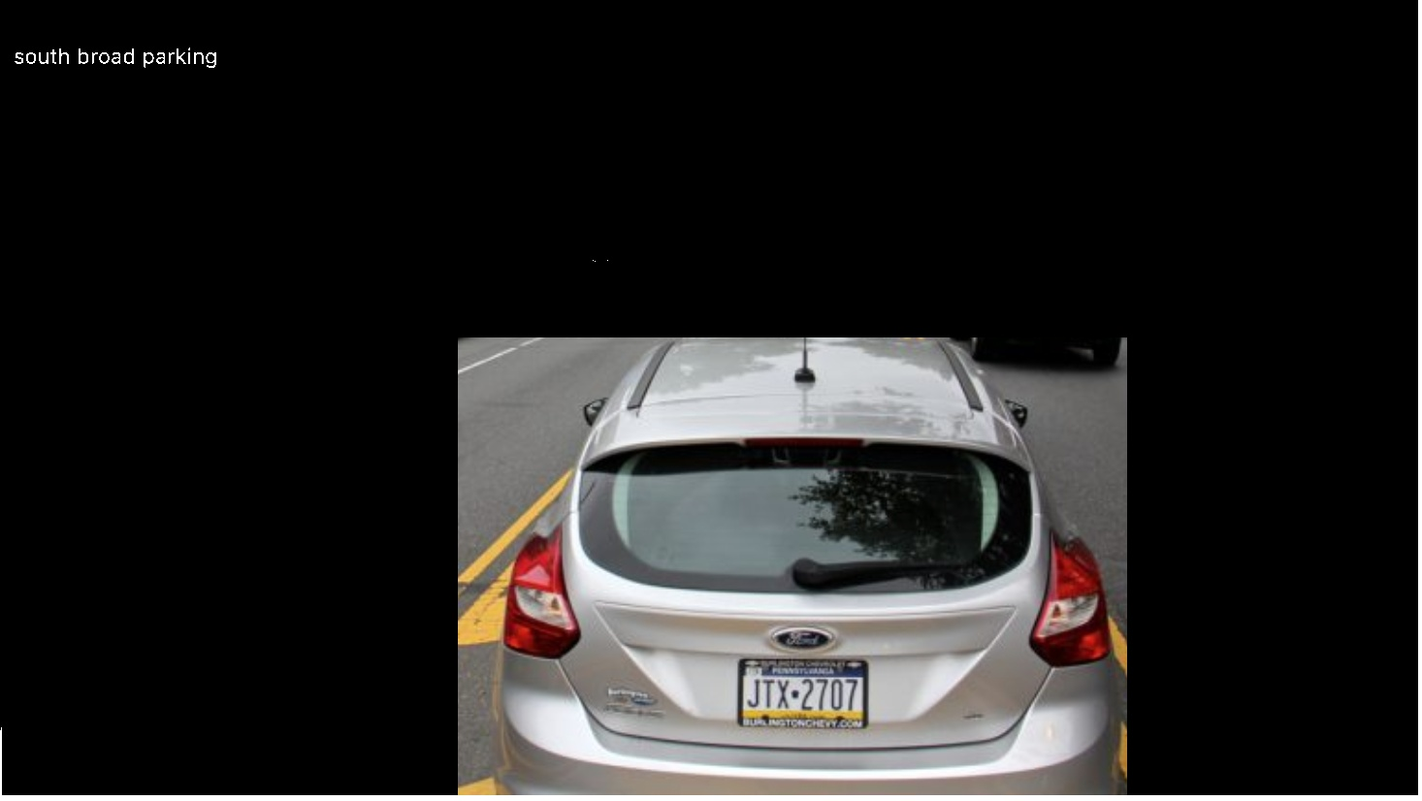
Graph Cut with GMM?
Need to manually select area of interest. It is probably the most reliable way, because human accuracy is definitely higher than computer. However, it is very time-consuming and we want the computer to do this work.

Slide 13
Thoughts and Future Work
There are many other segmentation techniques that can be tried.
If we have spare time and manually select area of interest as part of data preprocessing, will the results be significantly better?
How would performance be like if we a more basic but faster OCR tool like Tesseract?

Slide 14
Thanks!
References:
https://github.com/shuyteng/CS6476-Project
https://opencv-python-tutroals.readthedocs.io/en/latest/py_tutorials/py_imgproc/py_grabcut/py_grabcut.html
https://towardsdatascience.com/introduction-to-image-segmentation-with-k-means-clustering-83fd0a9e2fc3
https://www.openalpr.com/cloud-api.html
https://arxiv.org/abs/1506.01497
https://platerecognizer.com/number-plate-datasets/
https://arxiv.org/abs/1506.02640

